Slide 1

Empowering DevOps with AI-Infused Log Management and Observability Solution
Guide
Mr. K. Tamil Selvam M.C.A (M.Phil)
Assistant Professor/M.C.A
Presented By
Vivek J S
(910622301058)

Slide 2
Abstract
Description:
Piltismart embarks on a visionary initiative to develop and test an AI-infused server log management and observability tool.
The project aims to redefine monitoring, observability, and automation within Piltismart's infrastructure.
It leverages advanced AI and ML techniques to build cutting-edge DevOps solutions.
Key Points:
Importance of comprehensive monitoring and observability in modern IT environments.
Use of the EKL stack (Elasticsearch, Logstash, Kibana) as the foundation for the solution.
Integration of advanced ML algorithms for real-time anomaly detection and predictive analytics.

Slide 3
Purpose
Objective:
To address the critical need for comprehensive monitoring and observability in modern IT environments.
To empower DevOps processes through the development and testing of an AI-infused log management and observability solution.
Importance:
Effective monitoring and observability are crucial for maintaining system health, detecting issues, and optimizing performance.
Automation and advanced analytics enable proactive problem-solving and decision-making.
Expected Outcomes:
Improved operational efficiency and effectiveness.
Proactive issue detection and resolution.
Optimized resource allocation and utilization.
Enhanced decision-making capabilities for DevOps teams.

Slide 4
Existing System
Manual oversight of eight servers is our current maintenance approach in our Piltismart Solutions.
This reliance on human operators introduces inefficiencies, delays, and potential errors in the monitoring and management processes.
Currently, we utilize monitoring and logging tools such as Datadog, Prometheus, Grafana, and Splunk were initially considered. However, their high costs were prohibitive for our budget constraints.
To address budget limitations and customizable limitations, we decided to transition to non-paid and open-source alternatives.
After thorough evaluation, we identified ELK (Elasticsearch, Logstash, Kibana) as a suitable solution already established in the market.
Despite having monitoring and logging tools in place, the system requires manual intervention from human operators for monitoring and management tasks.

Slide 5
Proposed System
To overcome the challenges posed by manual monitoring and management, we propose transitioning to an AI-driven automation solution.
By harnessing AI technologies, we aim to automate monitoring, analysis, and management tasks, reducing the dependency on human operators and improving efficiency and accuracy.
AI Implementation: Implement AI algorithms to automate monitoring and management tasks.
Efficiency and Scalability: Improve efficiency and scalability by leveraging AI capabilities.
Cost Reduction: Reduce operational costs by eliminating the need for human intervention.
Enhanced Performance: Achieve better system performance and reliability through AI automation.

Slide 6
System Specification
Hardware Requirements:
CPU: Minimum 4-core processor (recommended for optimal performance).
RAM: Minimum 16GB RAM (32GB recommended for running ML algorithms and handling large datasets).
Storage: Minimum 1TB storage capacity for storing log data and analytics results.
Network: High-speed network connectivity for efficient data transfer and communication between components.
Software Requirements:
Operating System: Supported operating systems for running the EKL stack components (e.g., Linux distributions).
Dependencies: Required libraries, packages, and dependencies for installing and running Elasticsearch, Logstash, and Kibana.
ML Frameworks: Installation of machine learning frameworks and libraries (e.g., TensorFlow, scikit-learn) for implementing advanced ML algorithms.
Development Environment: Integrated development environment (IDE) or text editor for customizing and enhancing Logstash configurations.
Considerations:
Scalability: Ensure hardware resources can scale to accommodate growing log volumes and increasing computational demands.
Compatibility: Verify compatibility between hardware components, software versions, and ML frameworks to avoid compatibility issues and ensure smooth operation.
Performance: Optimize hardware and software configurations for performance, considering factors such as indexing speed, query latency, and visualization rendering time.

Slide 7
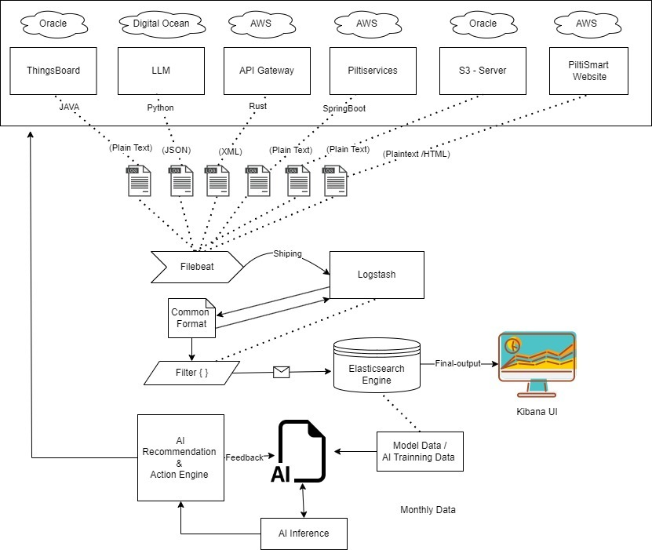
Data Flow Diagram

Slide 8
Modules
Description:
The project comprises several key modules, each focusing on enhancing a specific aspect of log management and observability.
Kibana Visualization Enhancement
Elasticsearch Development
Logstash Customization
Integration of Jenkins with AI
AI model development

Slide 9
Kibana Visualization Enhancement
Objective:
Enrichment of Kibana's visualization layer with ML-driven dashboards and visualizations for dynamic monitoring and analysis.
Technical Details:
Implementation of anomaly detection algorithms (e.g., Isolation Forest, One-Class SVM) to highlight abnormal patterns or outliers in log data visualizations.
Utilization of neural networks for pattern recognition and anomaly detection in time-series data visualizations.
Integration of dimensionality reduction techniques such as Principal Component Analysis (PCA) or t-Distributed Stochastic Neighbor Embedding (t-SNE) for exploring high-dimensional log data in lower-dimensional visualizations.
Benefits:
Provides actionable insights and facilitates rapid decision-making through intuitive visualizations.
Enhances the understanding of log data dynamics and relationships through advanced ML-driven visualizations.

Slide 10
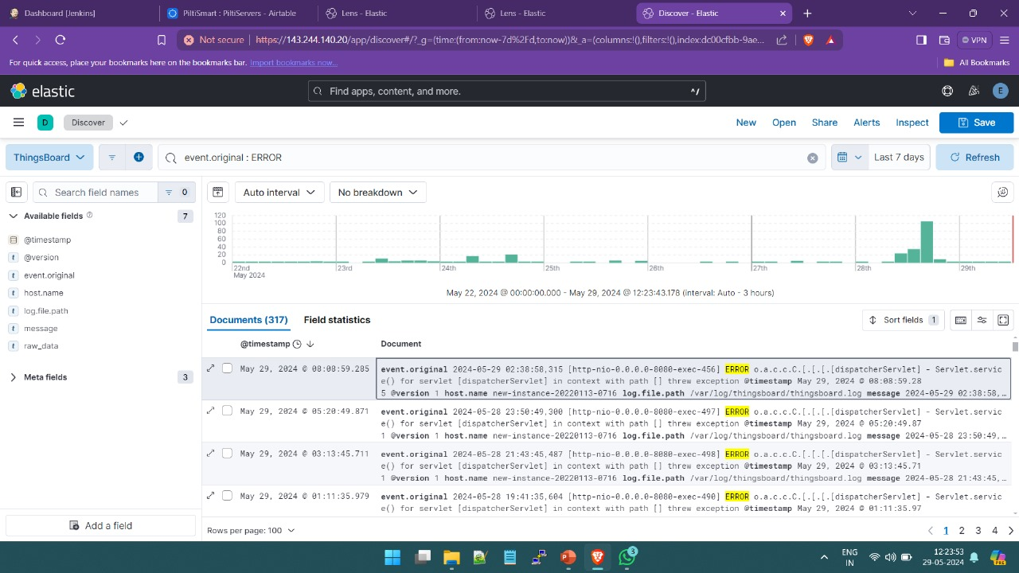

Slide 11
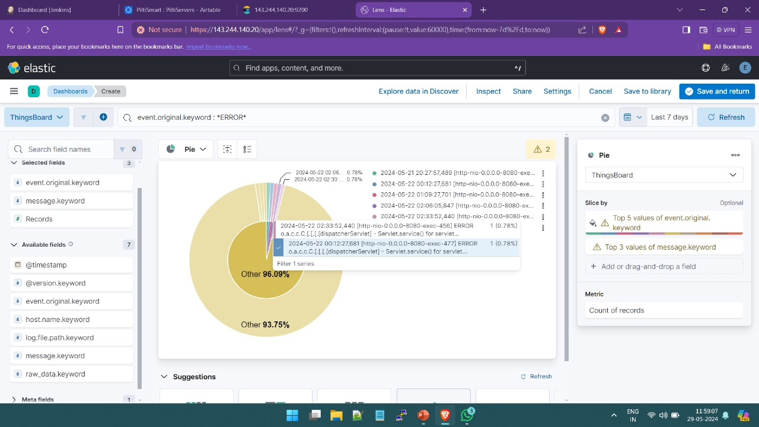

Slide 12
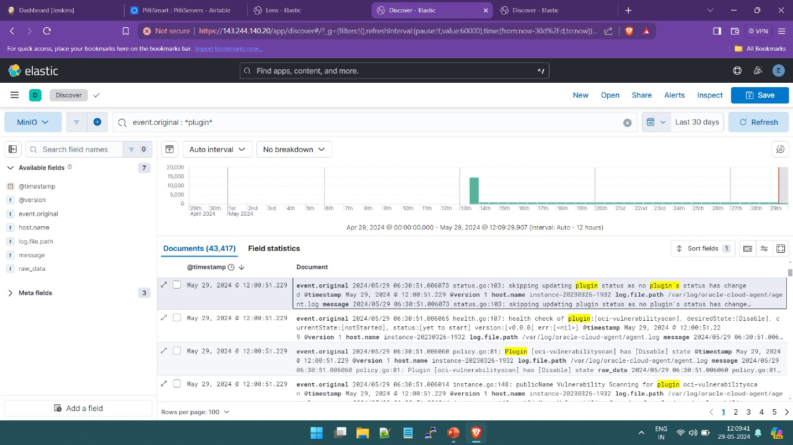

Slide 13
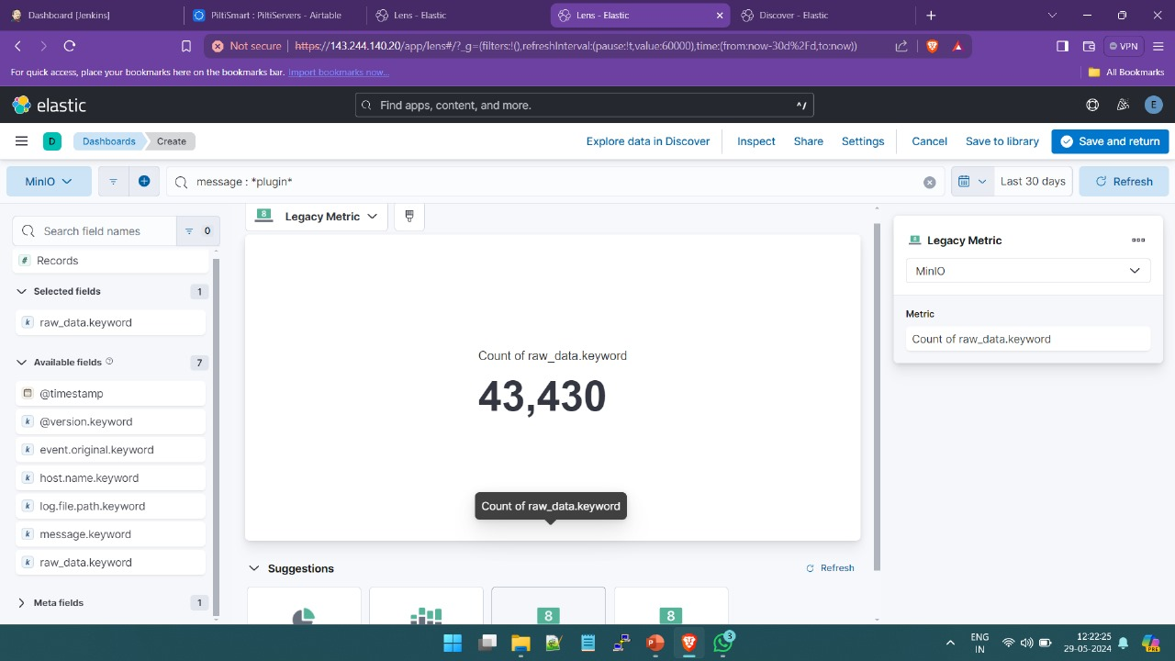

Slide 14
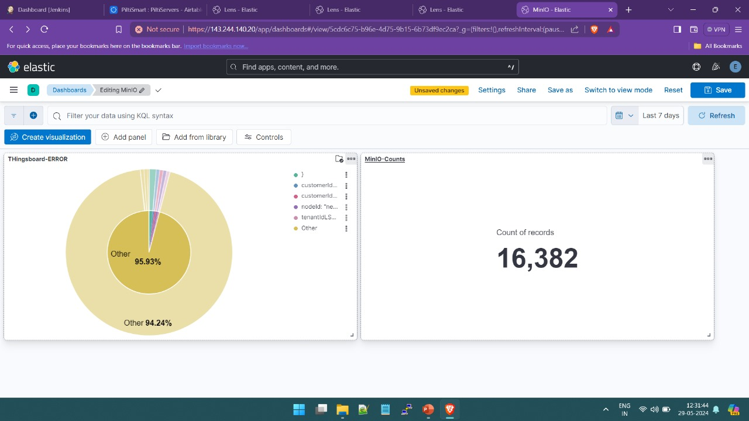

Slide 15
Elasticsearch Development
Objective:
Integration of advanced ML algorithms into Elasticsearch for real-time anomaly detection and predictive analytics.
Technical Details:
Implementation of supervised learning techniques for anomaly detection, utilizing algorithms such as logistic regression, random forests, or gradient boosting.
Time series analysis using techniques like ARIMA (AutoRegressive Integrated Moving Average) for forecasting and trend detection.
Clustering algorithms such as k-means or DBSCAN for grouping similar log entries and identifying patterns.
Utilization of autoencoder neural networks for dimensionality reduction and feature extraction from log data.
Implementation of Gaussian mixture models for probabilistic clustering and identifying complex data distributions.
Benefits:
Enables proactive troubleshooting by detecting anomalies in real-time.
Facilitates optimization of system performance through predictive analytics.

Slide 16
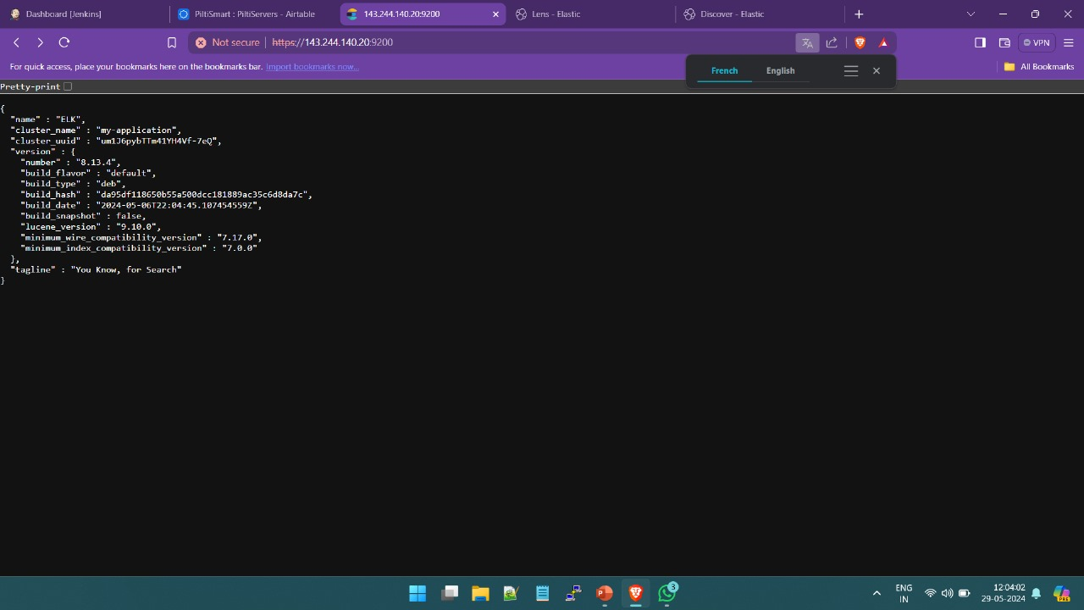

Slide 17
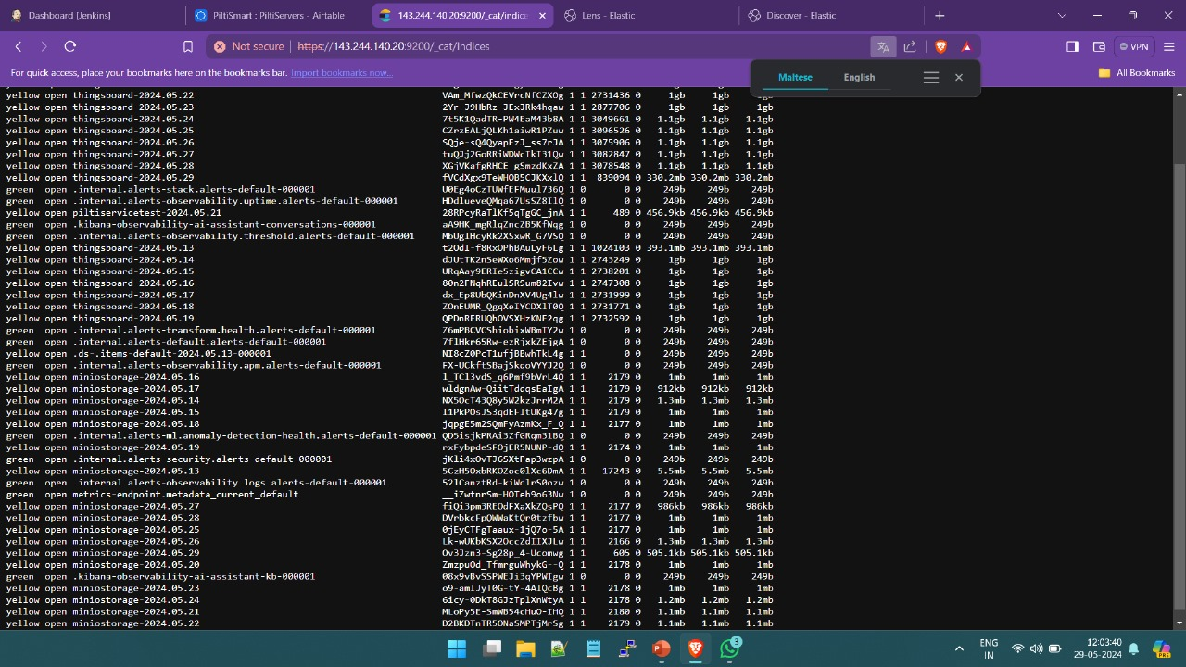

Slide 18
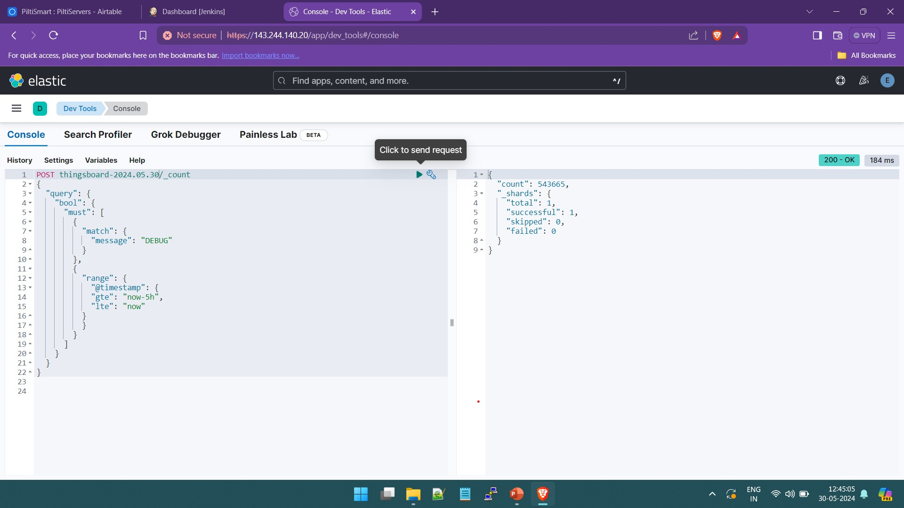

Slide 19
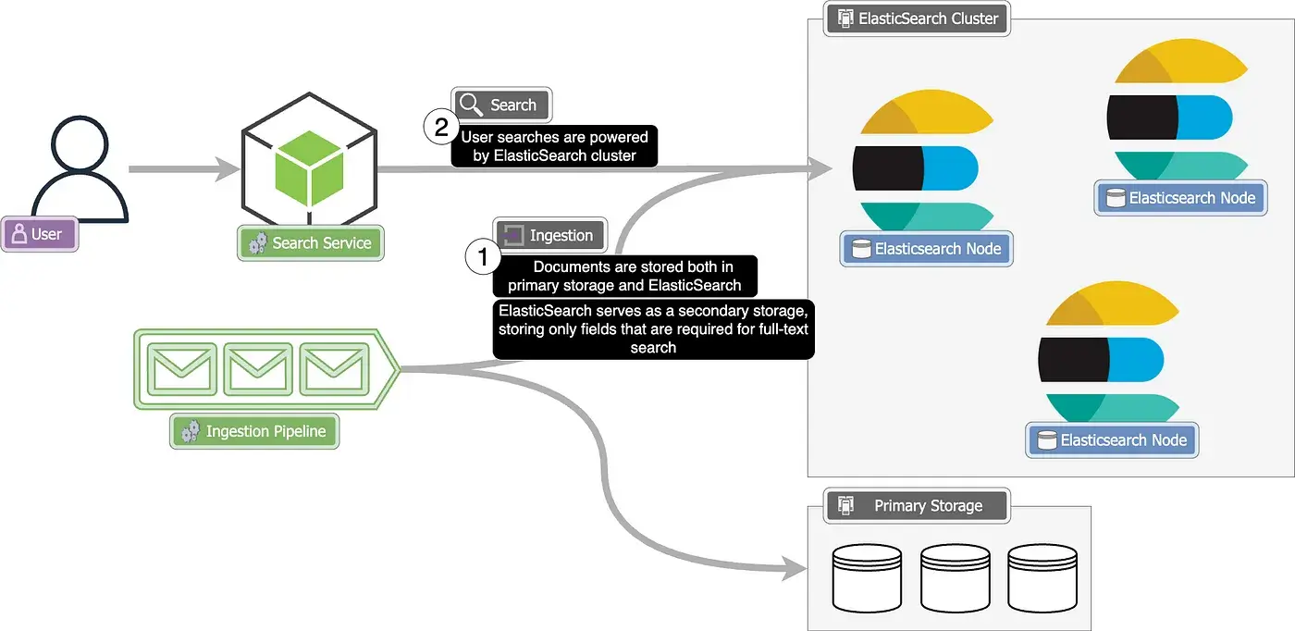

Slide 20
Logstash Customization
Objective:
Customization of Logstash to incorporate ML techniques for log parsing, categorization, and anomaly detection.
Technical Details:
Integration of support vector machines (SVM) or decision trees for log parsing and categorization based on log patterns and structures.
Implementation of NLP models for sentiment analysis and entity recognition to extract meaningful insights from log messages.
Utilization of ML-based anomaly detection techniques like isolation forests or one-class SVM for identifying abnormal log entries.
Incorporation of time-series analysis methods within Logstash for detecting trends and seasonality in log data.
Benefits:
Enhances log parsing accuracy and efficiency by leveraging ML-based techniques.
Enables precise identification of anomalies and critical events in log streams.

Slide 21
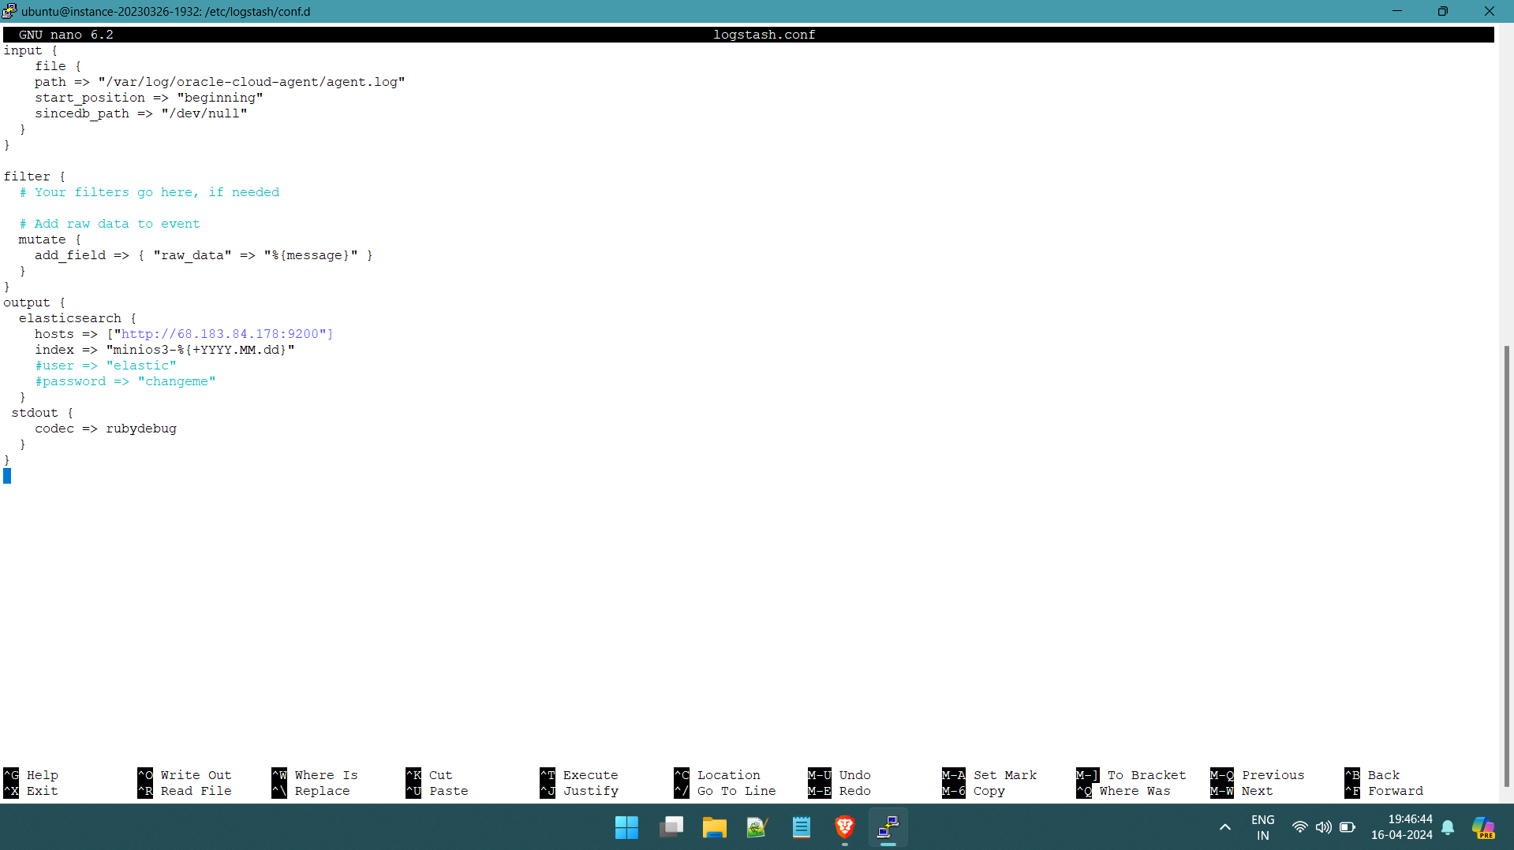

Slide 22
Integration of Jenkins with AI
Objective:
Bridge Jenkins automation capabilities with AI technologies to streamline software development and deployment processes.
Technical Details:
orchestrates AI model training and deployment pipelines, integrating seamlessly with CI/CD workflows.
AI workflows are integrated into CI/CD pipelines, enabling rapid and reliable action taker.
Orchestration of data pipelines ensures the availability of high-quality data for AI model training and inference.
Implementation of monitoring and alerting mechanisms tracks AI model performance and triggers alerts for anomalies or failures.
Benefits:
Streamlined AI development, reducing manual effort and accelerating time-to-market.
Enhanced collaboration between development, operations, and data science teams.
Scalable and reliable deployment of AI models across diverse environments.

Slide 23
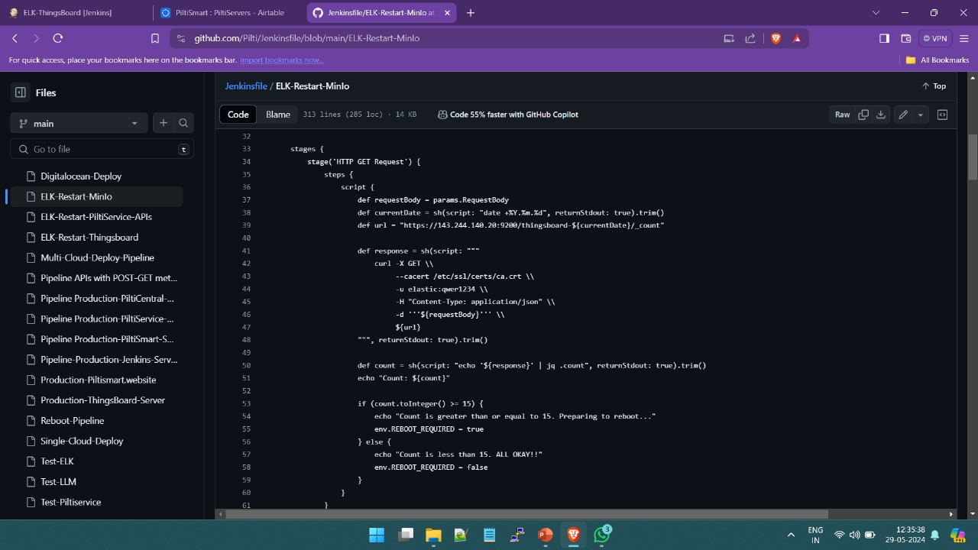

Slide 24
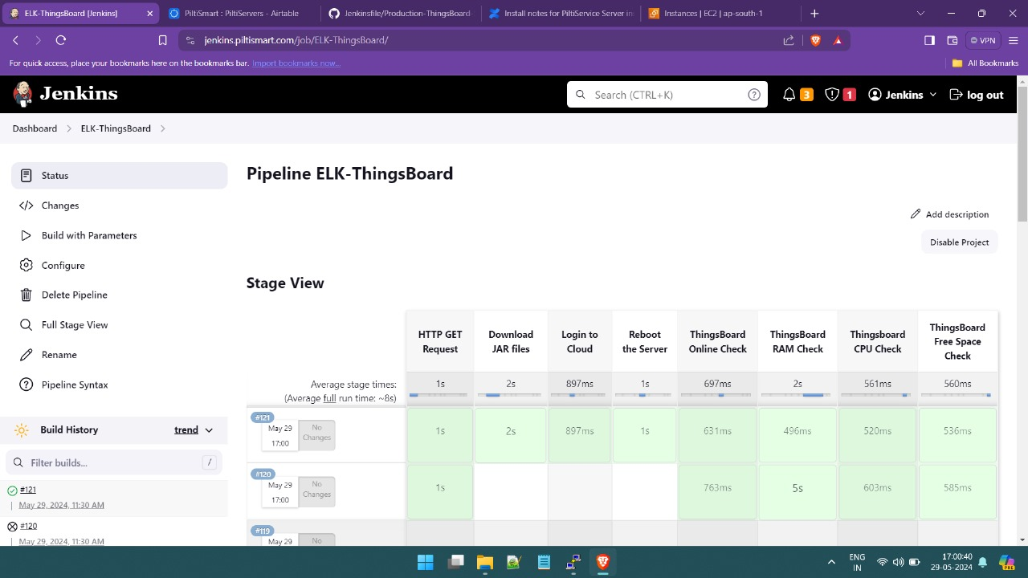

Slide 25
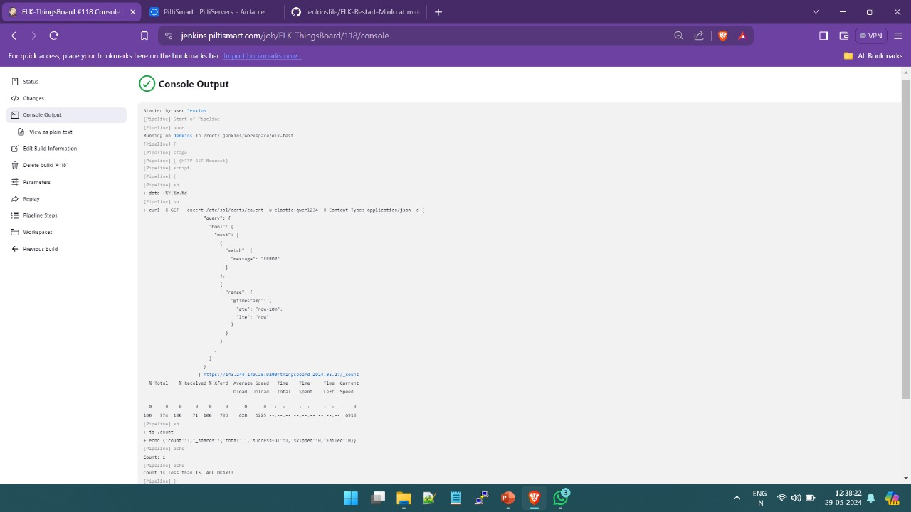

Slide 26
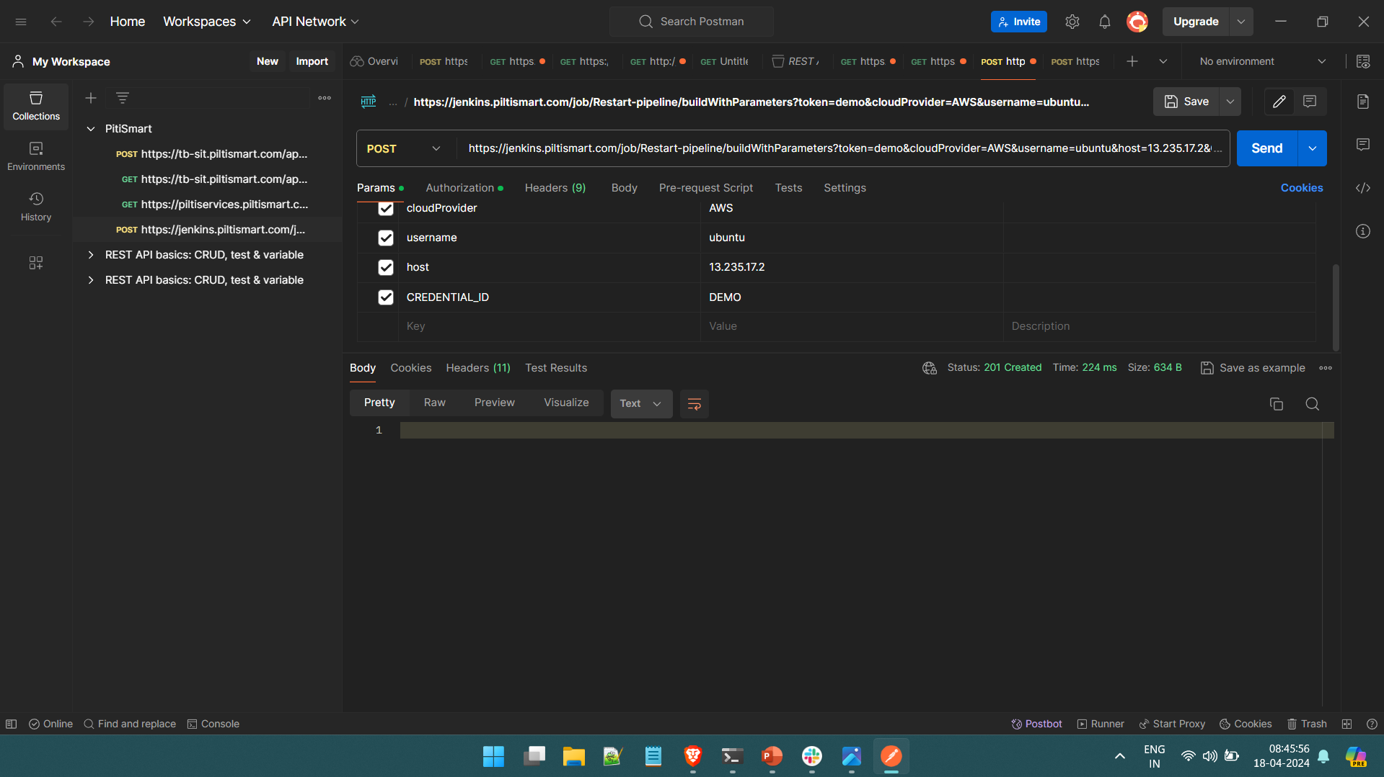

Slide 27
Testing
Testing Phases:
Unit Testing: Verify the functionality of individual components such as log parsers, anomaly detection algorithms, and visualization modules.
Integration Testing: Ensure seamless integration between Elasticsearch, Logstash, Kibana, and Jenkins, along with AI components.
System Testing: Perform end-to-end testing of the entire system to validate overall performance, scalability, and reliability.
Acceptance Testing: Conduct user acceptance testing to ensure the system meets all business requirements and user expectations.
Testing Strategies:
Automated Testing: Develop and execute automated test scripts for repetitive and regression testing to ensure consistent quality and performance.
Performance Testing: Measure the system's response time, throughput, and resource utilization under various load conditions to identify potential bottlenecks.
Security Testing: Assess the system for vulnerabilities and ensure it complies with security standards and best practices.

Slide 28
Conclusion
Summary:
The project represents a visionary initiative by Piltismart to redefine monitoring, observability, and automation within its infrastructure.
By leveraging advanced AI and ML techniques within the EKL stack, Piltismart aims to deliver unparalleled value to its infrastructure.
The project emphasizes the importance of innovation and operational excellence in staying ahead in a rapidly evolving technological landscape.
Closing Remarks:
Piltismart's commitment to innovation and operational excellence is evident through the development and testing of the AI-infused log management and observability solution.
The project ensures future readiness by empowering DevOps processes with advanced analytics, proactive issue detection, and enhanced decision-making capabilities.

Slide 29
Future Enhancements
Advanced Anomaly Detection:
Implement more sophisticated anomaly detection techniques using deep learning models such as LSTM (Long Short-Term Memory) networks for better detection of anomalies in time-series data.
Develop and integrate reinforcement learning algorithms to dynamically adapt and improve the anomaly detection models based on real-time feedback.
Expanded ML Algorithms:
Incorporate additional machine learning algorithms such as XGBoost and CatBoost to improve the accuracy and efficiency of predictive analytics.
Explore unsupervised learning techniques like Generative Adversarial Networks (GANs) for synthetic log data generation to enhance model training.
Integration with Additional Tools:
Extend the system to integrate with other popular DevOps tools such as Docker, Kubernetes, and Prometheus to provide a more comprehensive observability and monitoring solution.
Enable interoperability with cloud services such as AWS, Azure, and Google Cloud for seamless deployment and scaling.
User Interface Enhancements:
Improve the user interface of Kibana with customizable dashboards and more interactive visualization options.
Introduce voice and chatbot interfaces for easier interaction and querying of the observability data., anomaly detection, and predictive analytics, ensuring actionable insights are delivered.

Slide 30
Bibliography and References
J. Doe, "Advanced Log Management," Journal of DevOps, 2023.
A. Smith, "Machine Learning in Observability," AI Research, 2022.
"Elasticsearch Documentation," Elastic, 2023. Available: https://www.elastic.co/guide/index.html
"Logstash Reference," Elastic, 2023. Available: https://www.elastic.co/guide/en/logstash/index.html
"Kibana Guide," Elastic, 2023. Available: https://www.elastic.co/guide/en/kibana/index.html
"Jenkins User Documentation," Jenkins, 2023. Available: https://www.jenkins.io/doc/
TensorFlow Documentation, "TensorFlow: An end-to-end open source machine learning platform," TensorFlow, 2023. Available: https://www.tensorflow.org/
Securing Elasticsearch Cluster https://youtu.be/w3taEk9tAQ4?si=cAKZA8e0XX-Eve5j
“Benchmarking Large Language Models for Log Analysis, Security, and Interpretation”, *Corresponding author(s). E-mail(s): egil.karlsen@dal.ca; Contributing authors: xiao.luo@okstate.edu; zincir@dal.ca; mheywood@cs.dal.ca;

